Slide 1

GHOUSIA COLLEGE OF ENGINEERING
RAMANAGARA -562159
Base Paper : PHISHING WEBSITE DETECTION USING MACHINE LEARNING
SUBMITTED BY : UNDER THE GUIDANCE OF:
SHASHIDHAR GOWDA P (1GC21CS088) Prof. IRFAN KHAN B M
(Proffesor Dept of CSE)
SYED AFNAN KHUNDMIRI(1GC21CS095)
SYED OWAIZ UZ ZAMAN (1GC21CS098)
SYED TAUKEER ABDULLA (1GC21CS100)

Slide 2




ABSTRACT
Phishing Threat
Detection Approach
Phishing is a deceptive cyberattack that tricks users into reveal sensitive information like passwords , credit card numbers , or personal data
Leverages machine learning algorithms and detailed url analysis to accurately identify and classify phishing websites
Impact
The system significantly improves online safety by detecting phishing
threats early , thereby protecting the users from identity theft ,
enhancing trust in digital platforms , ad reducing financial and
reputational fraud losses

Slide 3
ABSTRACT
Phishing websites are fake and deceptive sites specifically designed to trick users into revealing personal information such as usernames, passwords, banking credentials, and other sensitive data. These malicious websites often appear very similar to genuine ones, making it difficult for users to detect the fraud. Traditional detection techniques, which usually rely on blacklists or manually crafted rules, often fail to catch newer, more advanced, and cleverly disguised phishing scams that constantly evolve.In our proposed approach, we used the Gradient Boosting Classifier as the machine learning model to effectively identify phishing websites based on various significant features extracted from URLs. This model is highly effective at handling complex data and improving prediction accuracy by combining multiple weak learners. By extracting and comparing numerous characteristics, such as URL length, domain age, use of HTTPS, and presence of special characters, between legitimate and phishing URLs, the classifier learns to distinguish harmful links from safe ones. Through this method, we aim to enhance the accuracy and reliability of phishing detection systems in a fast-changing digital environment.
PHISHING WEBSITE DETECTION

Slide 4
INTRODUCTION
Phishing is a major cybersecurity threat where attackers create fake websites to steal sensitive information such as usernames, passwords, and financial details. These fraudulent sites often mimic legitimate websites, making it difficult for users to identify them. Traditional phishing detection methods, such as blacklists and rule-based systems, are often ineffective against new and evolving phishing techniques.
To address this challenge, We have developed our project using a website as a platform for all the users. This is an interactive and responsive website that will be used to detect whether a website is legitimate or phishing. This website is made using different web designing languages which include HTML, CSS, Javascript and Flask framework in Python. The basic structure of the website is made with the help of HTML. CSS is used to add effects to the website and make it more attractive and user-friendly. It must be noted that the website is created for all users, hence it must be easy to operate with and no user should face any difficulty while making its use
PHISHING WEBSITE DETECTION

Slide 5
LITERATURE SURVEY
title
year
author(s)
methodology
advantages
drawbacks
Detecting Malicious URLs using Deep Reinforcement Learning
2018
Erzhou Zhu et al.
Used deep reinforcement learning to detect phishing URLs dynamically based on behavior patterns of criminal websites.
Learns phishing site properties adaptively; robust and flexible due to trial-and-error-based learning.
Model complexity and slow convergence; not ideal for real-time detection.
Feature Extraction from URLs and Webpage Links
2017
Seena Thomas
Extracted statistical and dictionary-based features from URLs, webpage content, and links. Used Deep Forest and other ML models for classification.
Deep Forest showed competitive performance; able to detect identity theft and compatible with multiple languages.
Slow due to need for analyzing many web pages; not effective for newly constructed phishing URLs.
PHISHING WEBSITE DETECTION

Slide 6
LITERATURE SURVEY
Analogy-Based Methods for Phishing Webpage Similarity Detection
2018
Basit et al.
Compared attacked web pages with known legitimate ones using analogy and similarity detection.
Can detect phishing based on similarity to previously identified threats.
Time-consuming; requires comparison with a large set of known pages.
Phishing Detection using Heuristic-Based Algorithms
2016–2018
Various researchers
Compared attacked web pages with known legitimate ones using analogy and similarity detection.
Can detect phishing based on similarity to previously identified threats.
Time-consuming; requires comparison with a large set of known pages.
PHISHING WEBSITE DETECTION

Slide 7
LITERATURE SURVEY
Deep Learning Approaches for Phishing Detection: A Systematic Review
2022
Catal et al.
Conducts SLR on Deep Learning-based phishing detection approaches.
Identifies DNN and Hybrid DL algorithms as the best-performing models.
Only focuses on Deep Learning studies.
Detection using Deep Forest, GBDT, and XGBoost
2019
Basit et al.
Represented URLs in vector form and used modern classifiers like GBDT and XGBoost.
High accuracy in detecting identity theft; supports multilingual environments; flexible feature usage.
Computationally intensive; performance may vary with unbalanced data.
PHISHING WEBSITE DETECTION

Slide 8




PROBLEM DEFINATION
Growing Phishing Attacks
Users face higher risk of data theft online.
Detection Challenges
Phishing sites are evolving and harder to spot.
Need for a new Detection Systems
Old detection methods are inefficient and error-prone.
PHISHING WEBSITE DETECTION

Slide 9

PROBLEM DEFINATION
Phishing attacks :
Phishing attacks are a growing cybersecurity threat where attackers create fake websites to steal sensitive user information such as passwords and financial data. Existing detection methods, often based on traditional machine learning models like Random Forest and Decision Trees, struggle with accuracy, adaptability to new phishing techniques, and lack user-friendly interfaces. There is a critical need for a more effective and intelligent system that can accurately identify phishing websites in real-time, reduce false positives, and provide an improved user experience.

Slide 10

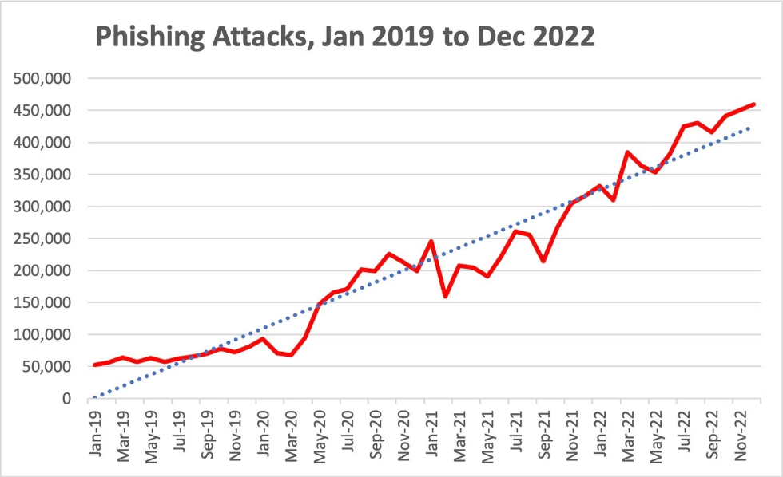
PROBLEM DEFINATION
Graphs :

Slide 11

PROBLEM DEFINATION
Detection challenges
Detecting phishing websites remains a complex challenge due to their constantly evolving tactics and deceptive designs. Phishers often mimic legitimate websites with high accuracy, making it difficult to distinguish them based on visual cues or domain names alone. The use of URL obfuscation, fast-flux hosting, and short-lived domains further complicates detection efforts. Moreover, machine learning models may struggle with generalization, as phishing techniques rapidly adapt to bypass known filters. Balancing detection accuracy with low false positives is critical, especially to avoid flagging legitimate sites and undermining user trust in security systems.
PHISHING WEBSITE DETECTION

Slide 12






LIMITATIONS OF EXISTING SYSTEM
Low accuracy in detecting sophisticated phishing websites.
Models have high latency, reducing real-time responsiveness.
No dedicated user interface for end-user interaction.
Limited to binary classification
Performance drops when working with small datasets.
Inability to adapt to new or evolving phishing tactics in real-time.
PHISHING WEBSITE DETECTION

Slide 13





PROPOSED SYSTEM
The system is trained on a dataset containing multiple URL-based features (excluding actual URLs) to classify websites as legitimate or phishing.
Features include alphanumeric patterns, keyword presence, domain identity, security indicators, and rank-based signals.
The trained model is integrated into a Flask-based web application with a responsive user interface built using HTML, CSS, and JavaScript.
Users can input a URL through the web app, which then classifies it in real time as phishing or legitimate.
Achieves improved detection accuracy of up to 97%, outperforming traditional ML methods like Logistic Regression and Naive Bayes.
PHISHING WEBSITE DETECTION

Slide 14

PROJECT OBJECTIVES
Enhance User Security
Validate Accuracy
Provide reliable alerts to prevent data theft.
Develop Detection Model
Test model with diverse phishing datasets.
Analyze Website Features
Implement machine learning for classification.
Identify key indicators of phishing sites.
PHISHING WEBSITE DETECTION

Slide 15

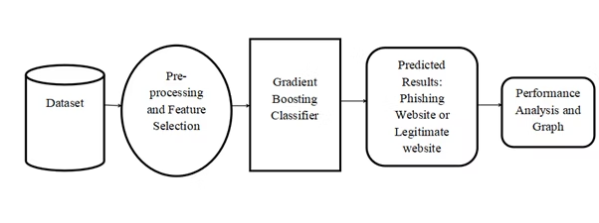
METHODOLOGY
Data Collection
Feature Extraction
Model Training
Testing & Validation
Gather URLs and website content from trusted sources.
Analyze URL length, SSL usage, and HTML content.
Use algorithms like SVM, random forest for detection.
Evaluate model performance on unseen data.

Slide 16
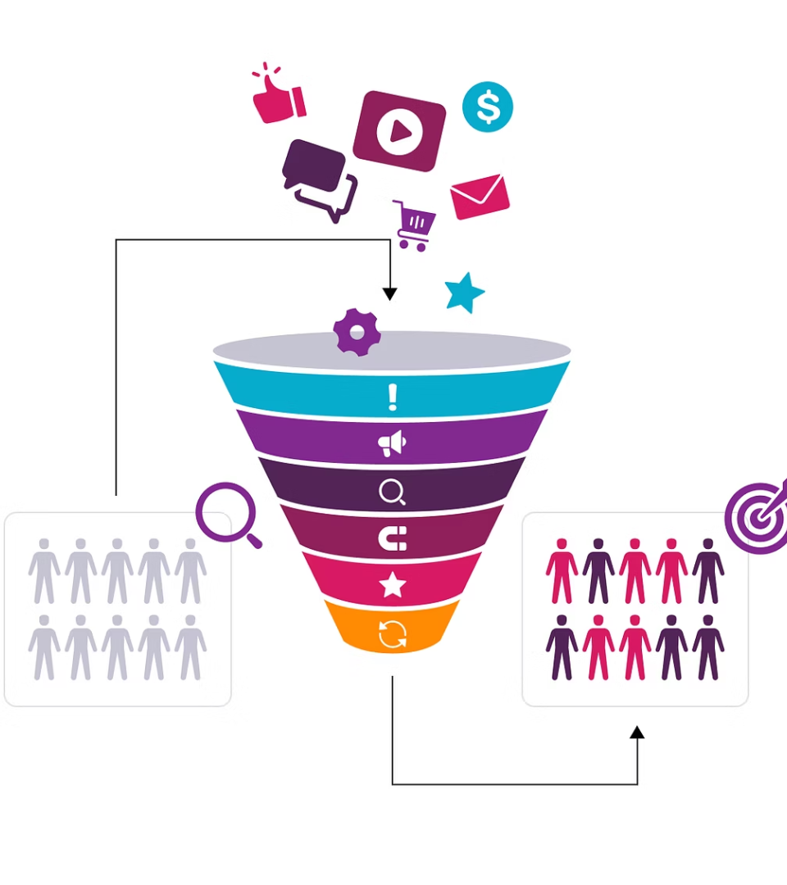
METHODOLOGY
Data collection
The dataset for this project was compiled from trusted sources like PhishTank and Kaggle, containing URLs labeled as either phishing or legitimate. These URLs include various characteristics useful for analysis, such as structure, length, and use of secure protocols. This labeled data forms the foundation for training and evaluating the machine learning model.

Slide 17

METHODOLOGY
Feature extraction
Feature extraction involves converting URLs into measurable attributes that help distinguish phishing sites from legitimate ones. In this project, key features such as URL length, presence of special characters, use of HTTPS, number of subdomains, and use of IP addresses were extracted. These features, selected based on common phishing patterns, were processed using a custom script to prepare the data for machine learning model training and prediction.
PHISHING WEBSITE DETECTION

Slide 18

METHODOLOGY
Model training
The extracted features were used to train a machine learning model capable of classifying URLs as phishing or legitimate. Algorithms like Random Forest were employed due to their high accuracy and robustness in handling complex patterns. The model was trained on a portion of the dataset and validated using the rest to ensure reliable performance and generalization to unseen data.

Slide 19

METHODOLOGY
Testing and Validation
After training, the model was tested using a separate portion of the dataset to evaluate its performance. Key metrics such as accuracy, precision, recall, and F1-score were used to validate the model's effectiveness in detecting phishing websites. This step ensured that the model not only performed well on training data but also generalized effectively to new, unseen URLs.
PHISHING WEBSITE DETECTION

Slide 20

Dataset Description
Attribute
Description
URL
Website address
Label
Phishing or legitimate classification
Features
Using IP, URL length, short URL usage, “@” symbol, redirection count, prefix/suffix in domain, subdomains, HTTPS presence, domain registration length, favicon source, non-standard ports, HTTPS in domain, external request URL, anchor tags, scripts linking externally, server form handler, info email, abnormal URL, website forwarding, custom status bar, right-click disabled, popup usage, iframe redirection, domain age, DNS record, website traffic, page rank, Google index, links pointing to page, statistical reports
Source
Phishtank , Kaggle

Slide 21
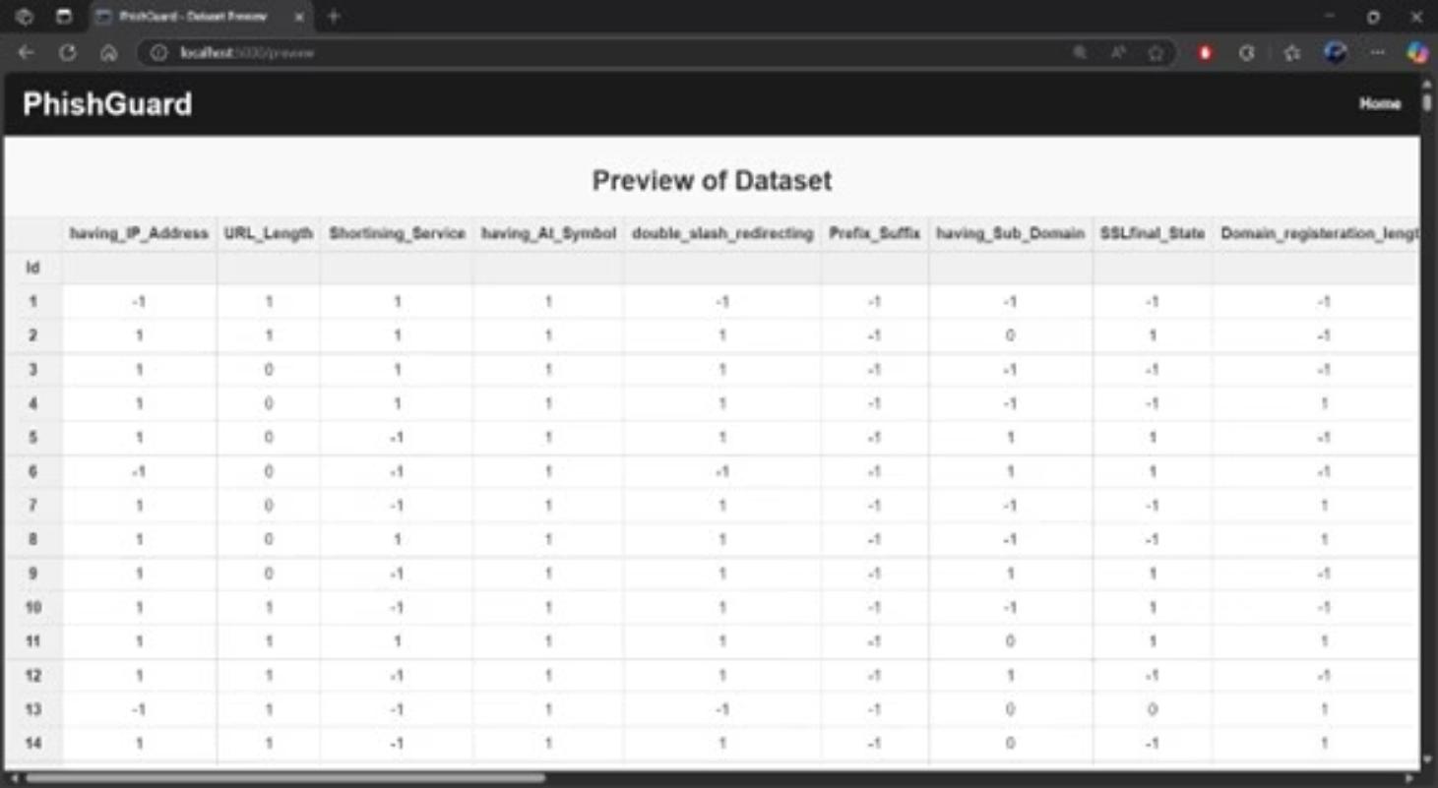
DATASET
PHISHING WEBSITE DETECTION

Slide 22
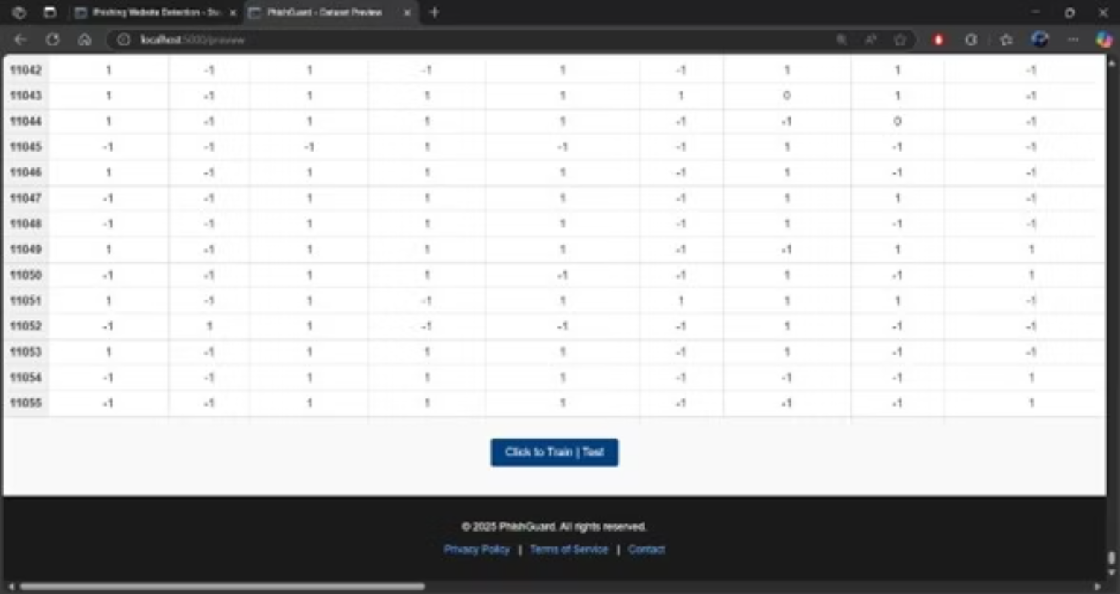
DATASET
PHISHING WEBSITE DETECTION

Slide 23
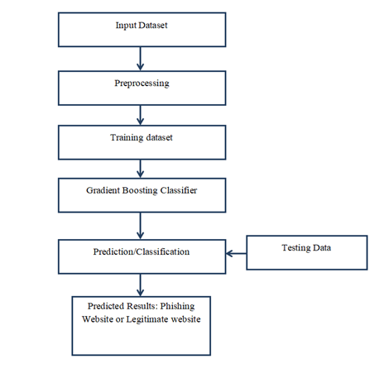
IMPLEMENTATION DETAILS
Preprocessing
Clean and format raw URL data for analysis.
Feature Engineering
Create numerical features from URLs and content.
Training ML Model
Build classification model with best algorithm.
Deploy & Test
Integrate detection into real-time applications.

Slide 24
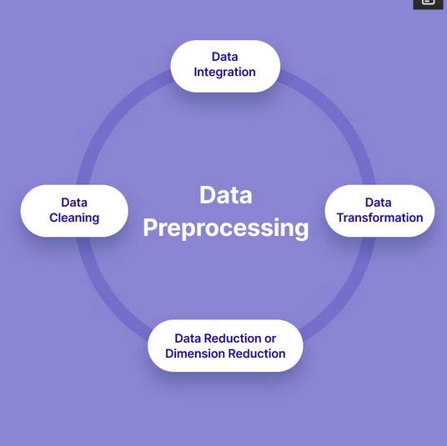
PREPROCESING
Libraries : pandas and numpy
The raw data is cleaned and organized using basic operations provided by pandas and numpy. This includes removing unnecessary columns, handling missing values, and preparing the data for feature extraction.

Slide 25
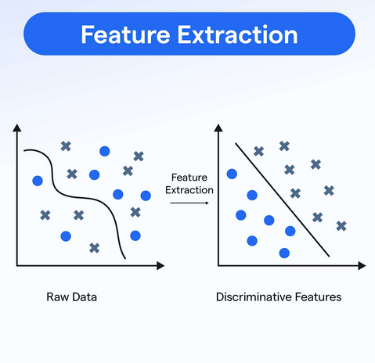
FEATURE EXTRACTION
Algorithm: Rule-based heuristic methods
Instead of using a prebuilt algorithm, the project uses custom-written rules to extract features from each URL. These rules check for things like if the URL has an IP address, how long the URL is, whether it uses HTTPS, the number of subdomains, and many more — all based on known patterns in phishing websites.
PHISHING WEBSITE DETECTION

Slide 26
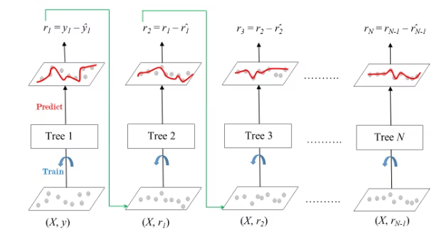

TRAINING ML MODEL
Algorithm : Gradient Boosting Classifier (GBC)
Libraries : sklearn.ensemble
This is a powerful machine learning algorithm that builds many small decision trees one by one. Each new tree tries to fix the mistakes made by the previous ones. This "boosting" process helps create a highly accurate model that can detect phishing websites effectively.

Slide 27

TESTING AND VALIDATION
Algorithm : Gradient Boosting Classifier
Libraries : sklearn.ensemble
After training, the same GBC model is used to predict whether new or unseen URLs are phishing or legitimate. The model makes decisions based on the patterns it learned during training and gives either a direct prediction or a probability score.
PHISHING WEBSITE DETECTION

Slide 28

PROJECT SNAPSHOTS
How End Users can navigate in our websites
PHISHING WEBSITE DETECTION

Slide 29
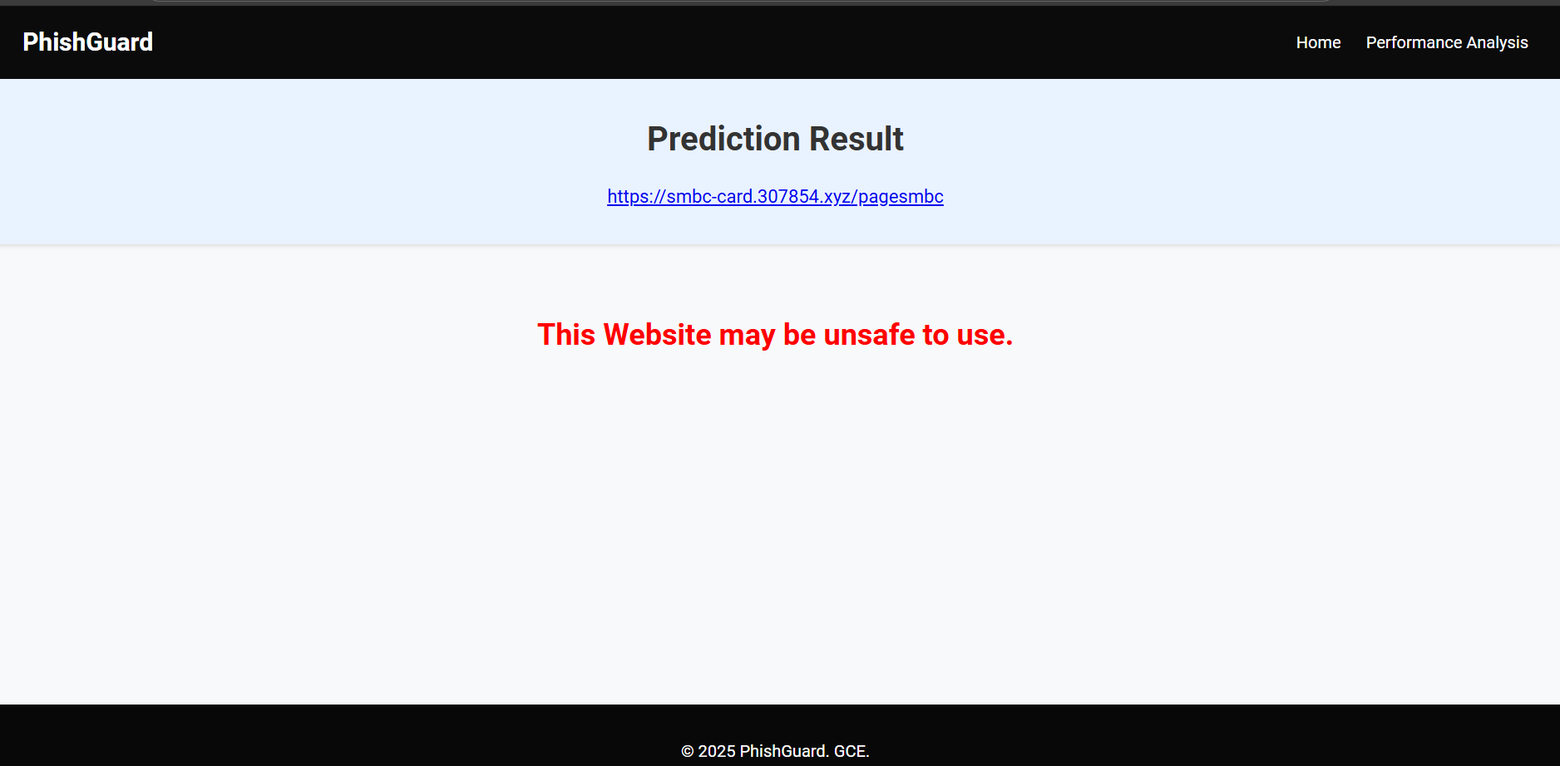
PHISHING WEBSITE DETECTION

Slide 30
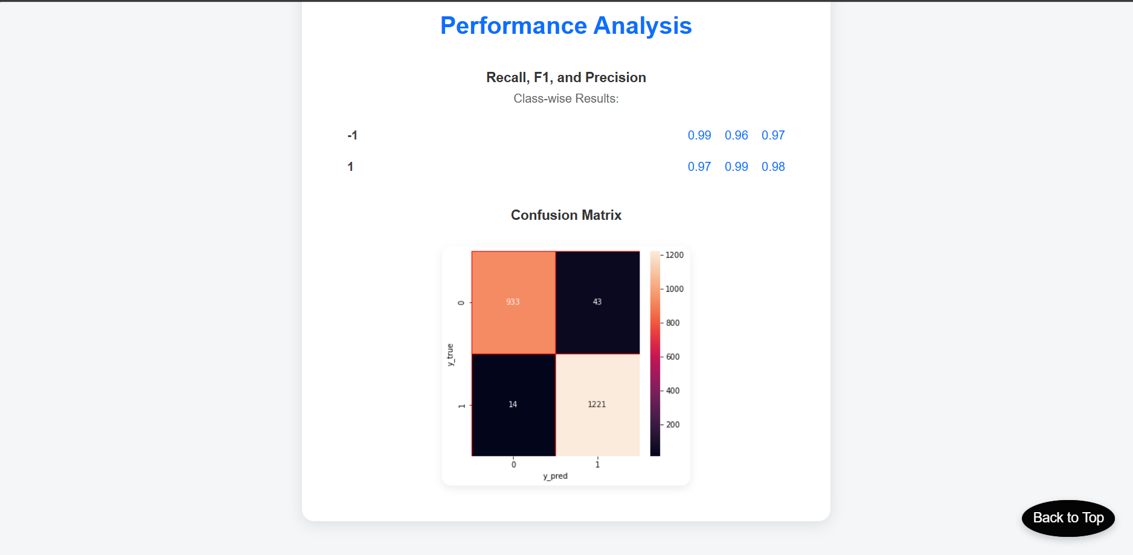
PHISHING WEBSITE DETECTION

Slide 31
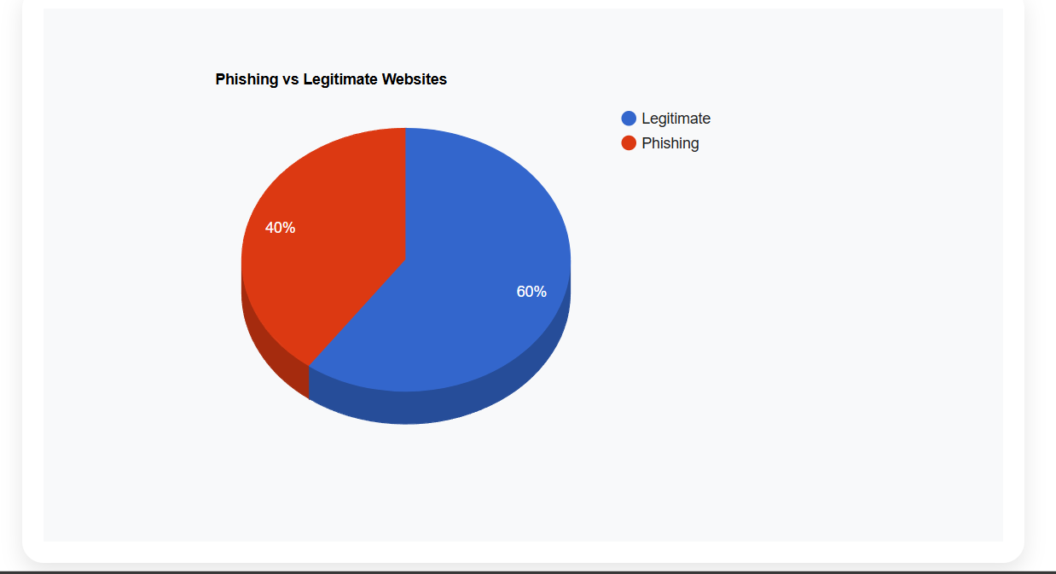
PHISHING WEBSITE DETECTION

Slide 32
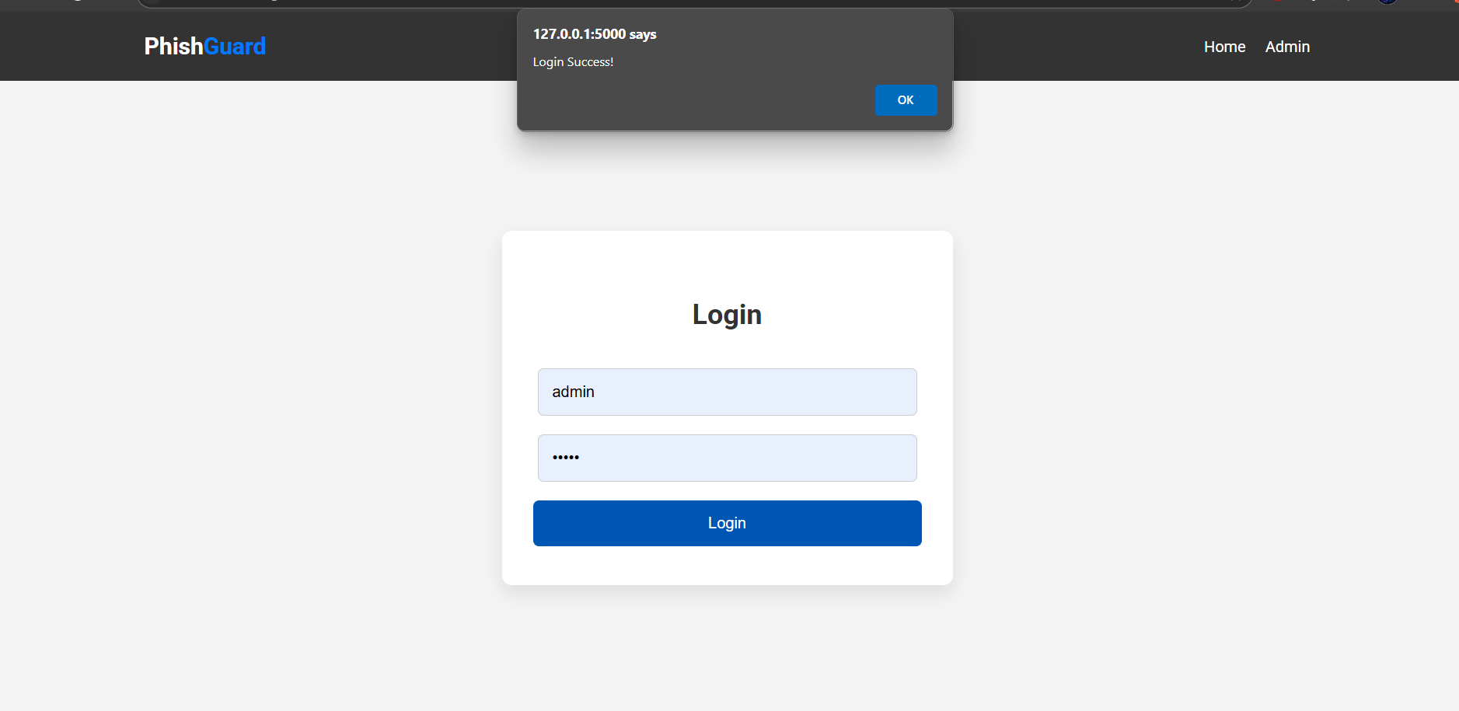
Admin panel
PHISHING WEBSITE DETECTION

Slide 33

PHISHING WEBSITE DETECTION

Slide 34
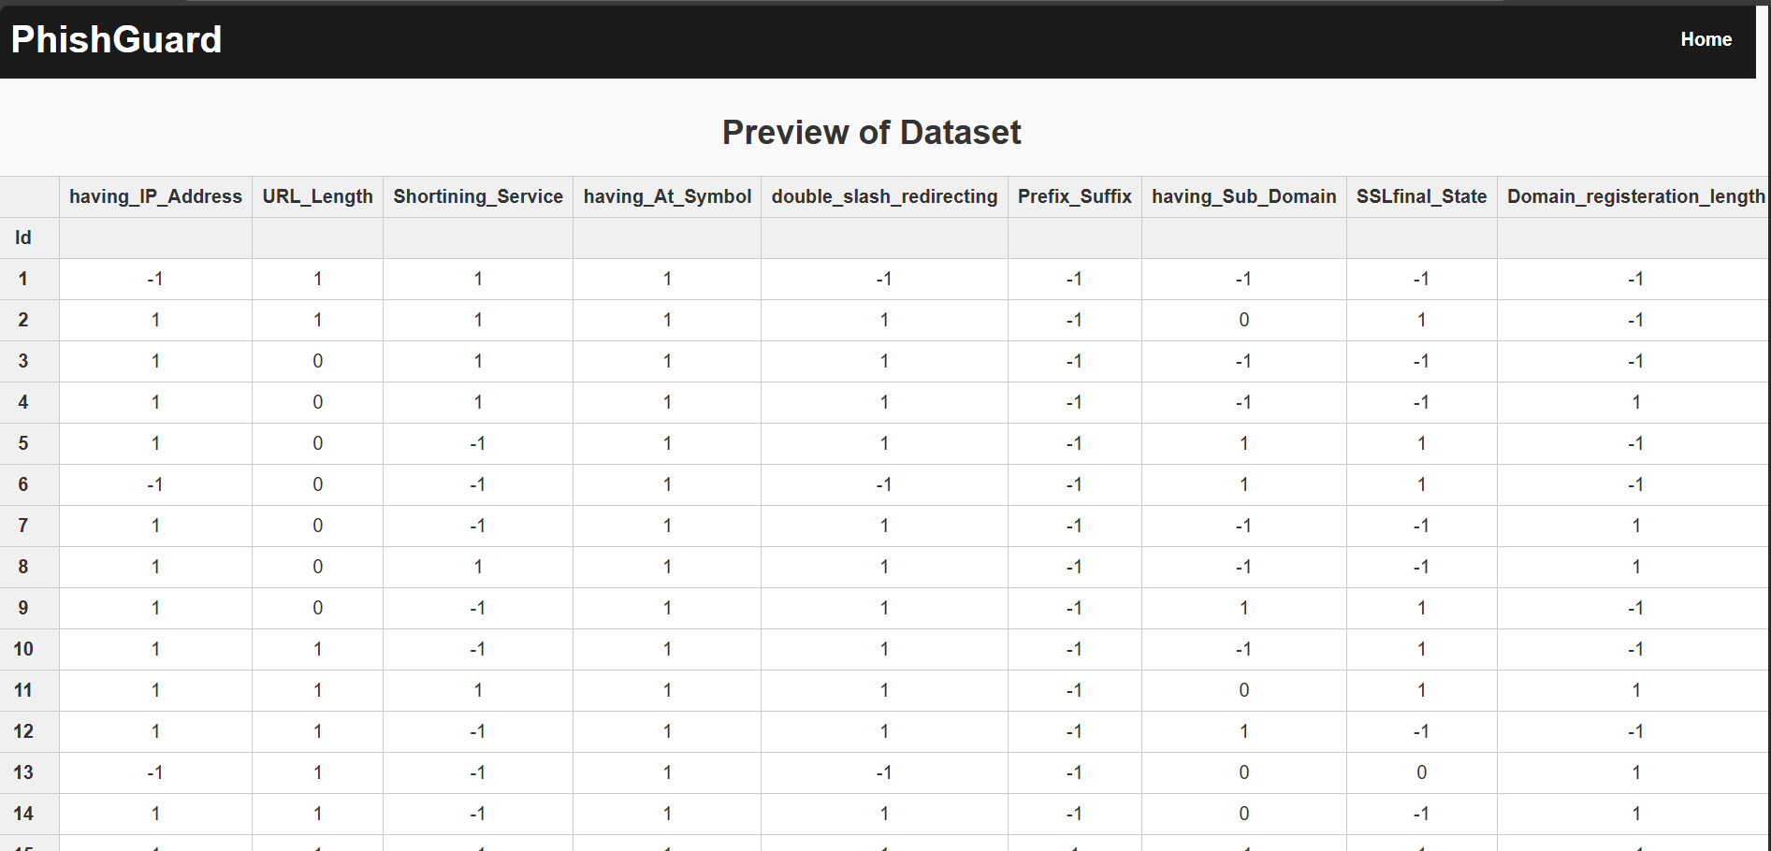
PHISHING WEBSITE DETECTION

Slide 35
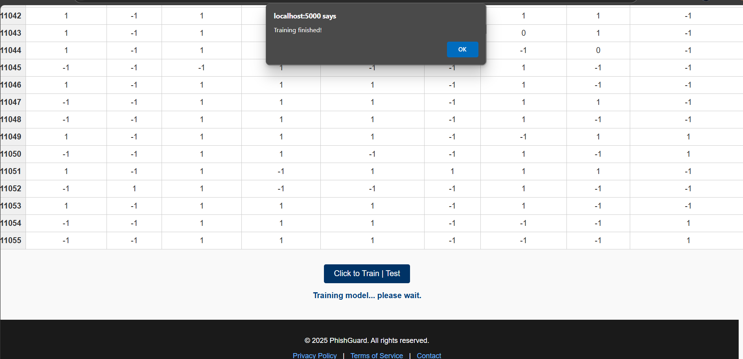
PHISHING WEBSITE DETECTION

Slide 36
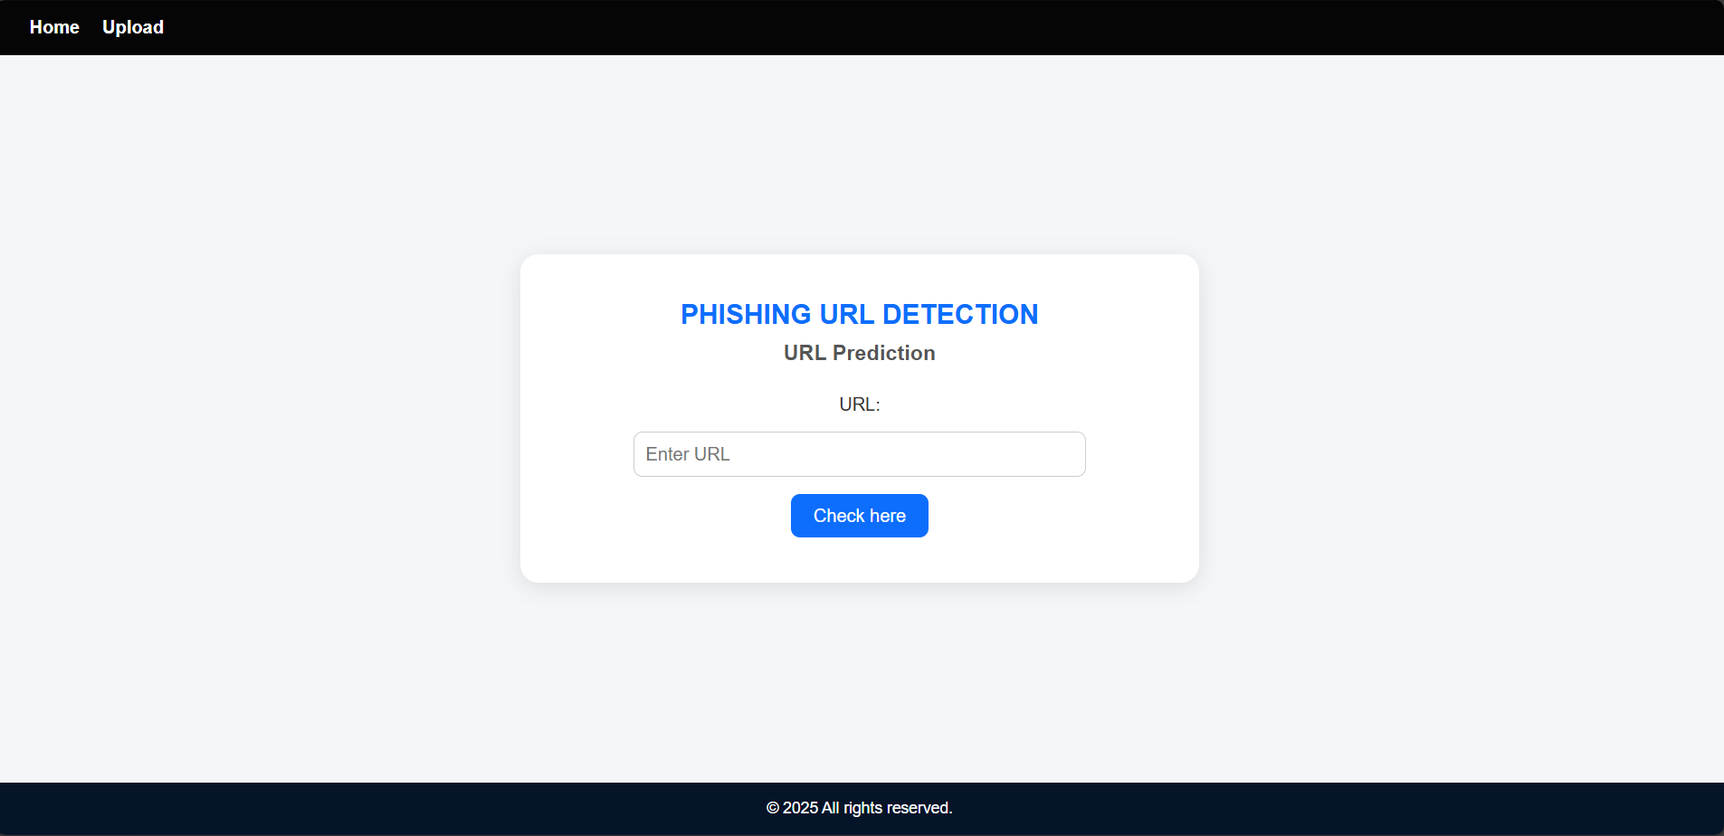
PHISHING WEBSITE DETECTION

Slide 37
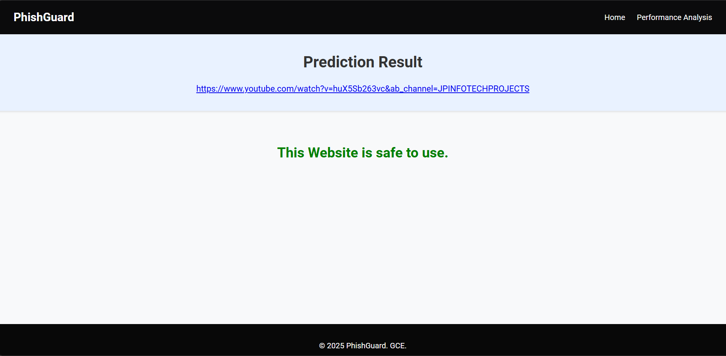
PHISHING WEBSITE DETECTION

Slide 38
FUTURE SCOPE
1
Real-time Detection Integration
2
Deep Learning Implementation
The model can be integrated into web browsers or email clients to detect phishing links in real-time, warning users before they interact with malicious websites.
Future versions of the system can use deep learning techniques such as LSTM or CNN models to analyze URLs, website content, and even screenshots for more accurate detection.
3
Browser Extension Development
4
Automatic Feature Updating
A browser extension can be created to use the trained model directly within users' browsers. It can analyze links on webpages and provide instant alerts for suspected phishing URLs.
As phishing tactics evolve, the system can be enhanced with automated feature extraction and periodic model retraining using fresh data from live threat feeds and cybersecurity APIs.
PHISHING WEBSITE DETECTION

Slide 39

CONCLUSION
High Accuracy: The Gradient Boosting Classifier effectively detects phishing websites by analyzing key URL and webpage features.
Reliable Performance: The model demonstrates strong metrics in accuracy, precision, and recall, making it suitable for real-world deployment.
PHISHING WEBSITE DETECTION

Slide 40
REFERENCES
Friedman, J. H. (2001). Greedy Function Approximation: A Gradient Boosting Machine. Annals of Statistics, 29(5), 1189–1232.
Natekin, A., & Knoll, A. (2013). Gradient Boosting Machines, A Tutorial. Frontiers in Neurorobotics, 7, 21.
Zhang, C., Sheng, S., Wardman, B., Warner, G., Cranor, L. F., & Hong, J. (2009). Phishing Blacklists: An Empirical Study. In CEAS 2009.
Khonji, M., Jones, A., & Iraqi, Y. (2013). A Literature Review on Phishing Detection. IEEE Communications Surveys & Tutorials, 15(4), 2091–2121.
Cranor, L., Xiang, G., Hong, J. I., & Rosé, C. P. (2011). CANTINA+: A Feature-Rich Machine Learning Framework for Detecting Phishing Websites. ACM TISSEC, 14(2).
PHISHING WEBSITE DETECTION

Slide 41
THANK YOU
PHISHING WEBSITE DETECTION

